Slide 2
Introduction
Rapid growth in data, mobility, and multimedia services
Need for flexible, scalable, cost-effective networks
Transition from hardware-centric to software-defined networking

Slide 3
NFV
Virtualization of network functions (firewall, router, load balancer, etc.)
Runs on standard servers instead of proprietary hardware
Key goal: reduce cost, improve agility, and enable rapid innovation

Slide 4
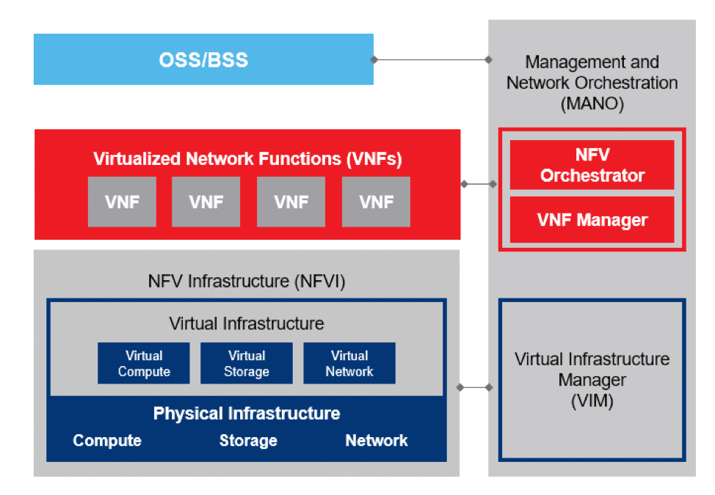
NFV Architecture
NFV Infrastructure (NFVI) – hardware + virtualization layer
Virtual Network Functions (VNFs) – software versions of network functions
Management & Orchestration (MANO) – control, automation, lifecycle management.

Slide 5
Advantages and Disadvantages
Advantages:
Reduced CAPEX & OPEX
Faster service deployment
Scalability and flexibility
Disadvantages:
Performance overhead
Security risks
Interoperability issues

Slide 6
NGN
Packet-based, IP-based converged network
Supports voice, data, video, mobility on same platform
Separation of service layer and transport layer

Slide 7
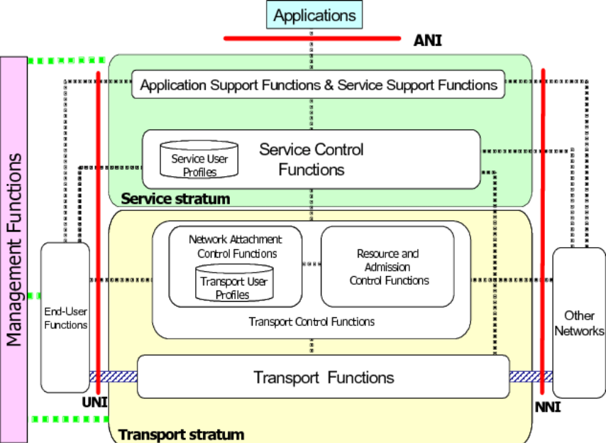
NGN Architecture
Applications: User services (VoIP, IPTV, IoT, etc.) connect via ANI.
Service Stratum: Handles service logic, control, user profiles, and authentication.
Transport Stratum: Provides actual data transfer, QoS, and user network access.
Interfaces:
UNI (User ↔ Network),
NNI (Network ↔ Network),
ANI (Apps ↔ Network).
Management Functions: Oversee operation, administration, and maintenance across all layers.

Slide 8
Advantages and Disadvantages
Benefits:
Convergence of multiple services
Better QoS & mobility support
Scalability for future services
Challenges:
Migration from legacy systems
Security threats
Standardization & regulation

Slide 9
Uses
NFV
Virtual firewalls, routers, EPC
SD-WAN
5G Core & Cloud-native telecom
NGN
VoIP replacing PSTN
IPTV over broadband
Mobile broadband (4G/5G)
IoT device connectivity

Slide 10
NFV & NGN Combined
NFV enables NGN by providing flexible virtualized infrastructure
NGN needs NFV for cost efficiency and scalability
Together → support 5G, IoT, edge computing, smart cities
Future Trends
NFV + SDN = fully automated, programmable networks
5G and upcoming 6G powered by NFV/NGN
Edge computing integration
AI-driven network management

